Slide 1
OWASP AppSec Pipeline Project: Automate all the AppSec
Aaron Weaver, Cengage Learning
Matt Tesauro, OWASP

Slide 2
Notes:
OWASP has a lot of material, but it doesn’t have a place to share useful information about running an AppSec team and collate the OWASP materials.

Slide 3
Background
Officially launched the OWASP Project AppSec Pipeline at AppSecEU Amsterdam 2015
Taking the Principles of DevOps and Agile applying them to AppSec

Slide 4
How has it resonated?
“Used your AppSec Pipeline in a Senior Executive meeting. Well done!”

Slide 5
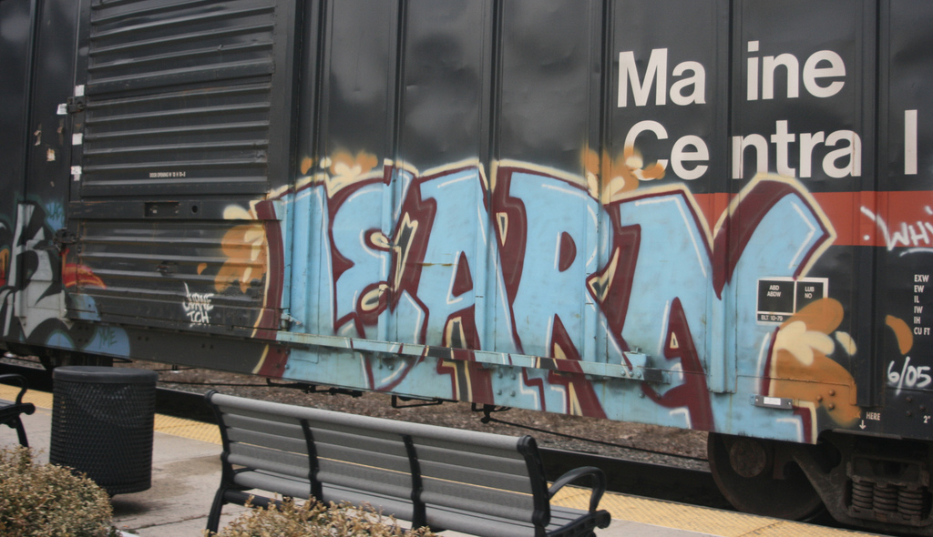
What did we learn?

Slide 6
Spending time
optimizing anything
other than
the critical resource
is an illusion.
-W. Edwards Deming

Slide 7
For AppSec:
It’s People

Slide 8
Continues to be the case.
There isn’t a long queue of qualified AppSec people.

Slide 9
5x Improvement
Notes:
Team changed

Slide 10
Results
2014
44 assessments
2015
~200 assessments
Notes:
Changes from 2014 to 2015:
Created the AppSec Pipeline - initial launch in March 2015
AppSec team numbers dropped - lost a couple of key people approx 3.5 FTEs
Two of the AppSec team members went meta for most of 2015

Slide 11
Received well outside of AppSec
O’Reilly Velocity Conference

Slide 12
We need to do more outside
of the security bubble.

Slide 13
AppSec Tools should be self service

Slide 14
Agile in Security
“We ran Agile with our application security group. Agile is an experiment, and everyone conducts it differently. The key is taking that first step and having people on your team who are willing to try, take a risk, and do something different. You learn how to work slowly over time.”
-Jon Rose, CSO Dun & Bradstreet
http://goo.gl/qCH7cC

Slide 15
A data pump is at
the heart of the Pipeline

Slide 16
Your finding repository is your source of truth for the Pipeline

Slide 17
“we don’t want to be locked into any particular vendor.”
-Oleg Gryb, Samsung

Slide 18
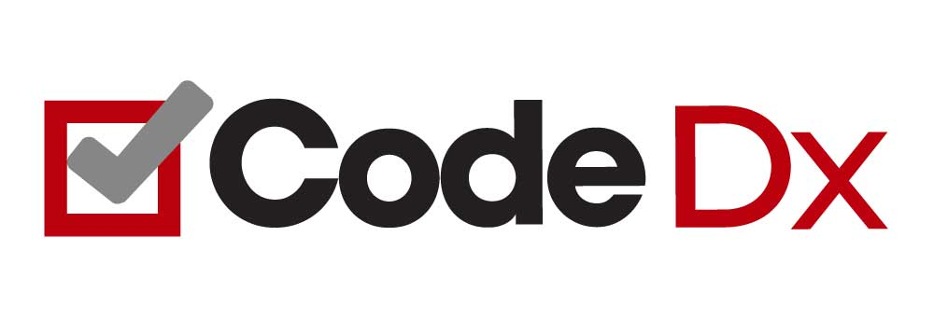
Finding Repository
NetSPI’s
OWASP Pipeline
Notes:
Asynchronous scanning (via sidekiq) that scales
Advanced false positive filtering
Publish issues via GitHub or JIRA
Track statistics and graph security trends in your applications
Integrates with a variety of open source and commercial scanning tools
Full REST API for extension and integration with other tools, CI processes, etc.

Slide 19
A New Role
We are seeking an accomplished software builder and breaker to bridge gaps between software development and information security. Traditionally, information security is siloed from development and reports are sent through emails. Our client, a Fortune 150 company, wants to work at a faster, more efficient pace. DevOps... but for security. We are seeking someone to help create and own new APIs and services, allowing security and software development tools to interact through automation.

Slide 20
A New Role
The goal is to enable developers to create secure and simple products.
The team is responsible for the definition, selection, testing, configuration and/or development of security testing tools (both static and dynamic) as well as building our own tools. Special focus is made on improving tool support for Open Source Software (OSS) Security – helping development projects to make informed decisions.

Slide 21
http://www.slideshare.net/SonatypeCorp/nexus-and-continuous-delivery

Slide 22
Case Studies
How are AppSec Pipelines
used in the real world?

Slide 23
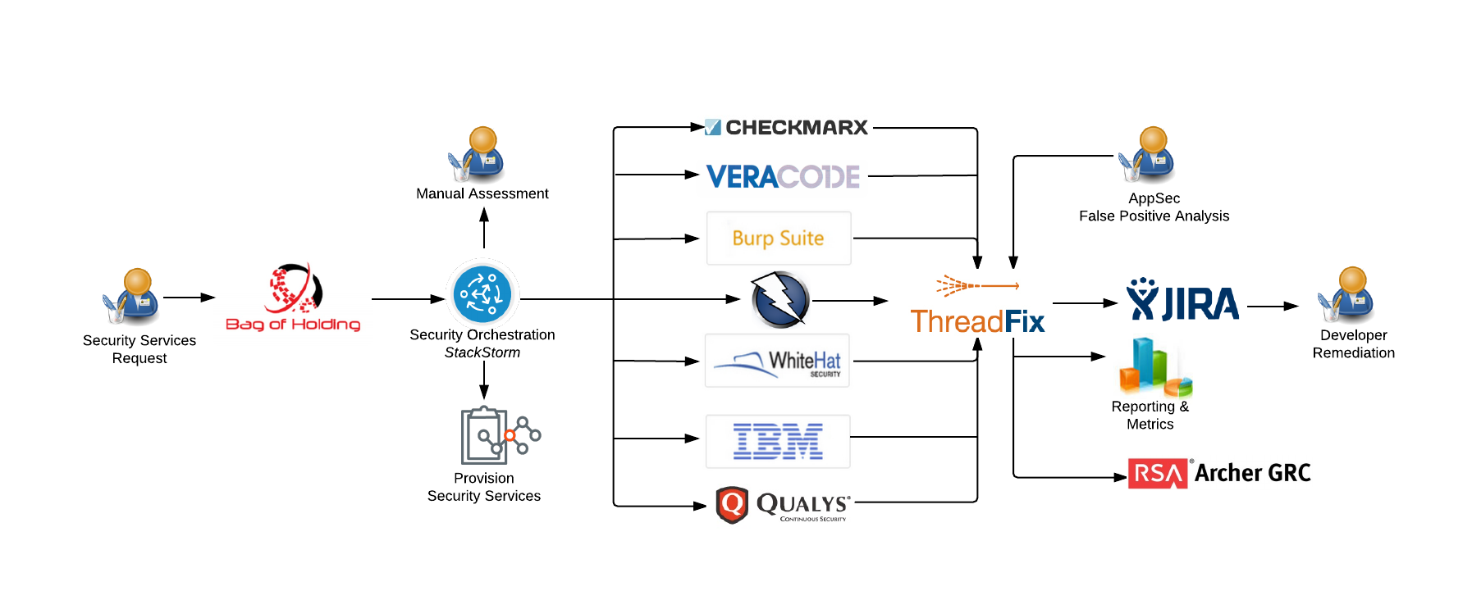
The “Original”

Slide 24
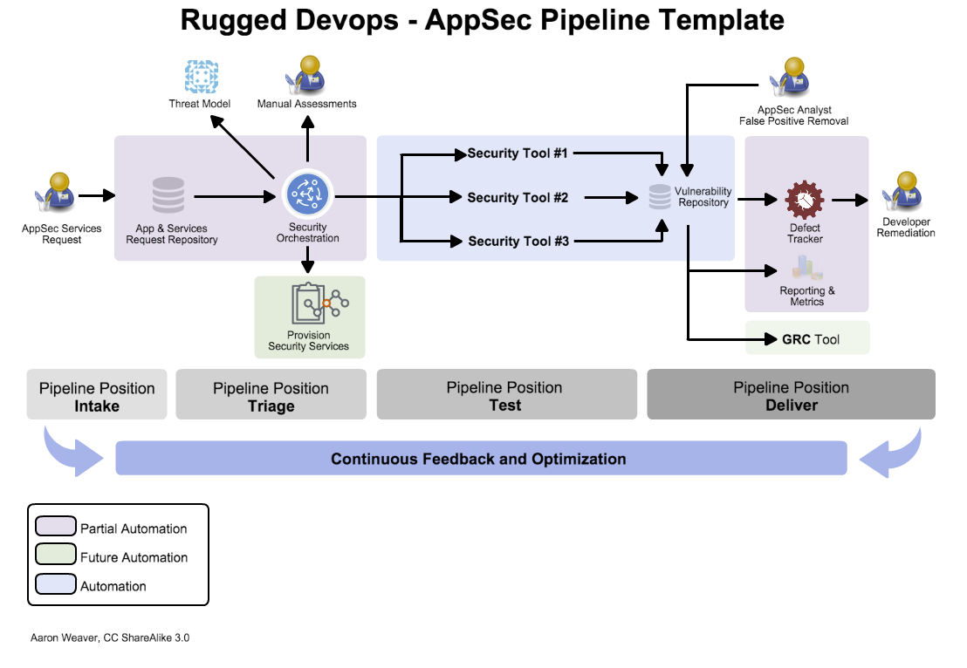
AppSec Pipeline Template

Slide 25
Financial Institution

Slide 26
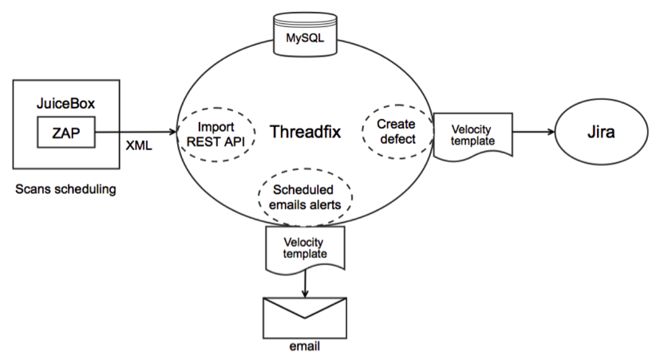
Large Multinational Conglomerate
Notes:
“The goal is full automation. This allows us to continuously evaluate, improve, and change out tools without disrupting the build pipeline.”

Slide 27
Intake
Test
Delivery
Education Company
Notes:
“The goal is full automation. This allows us to continuously evaluate, improve, and change out tools without disrupting the build pipeline.”

Slide 28
Reference AppSec Pipeline Architecture
http://goo.gl/b4SXin
Submit your AppSec Pipeline: aaron.weaver@owasp.org

Slide 29
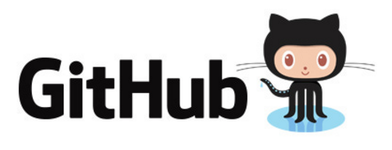
Shifting Left
Security tools are making more efforts to make their tools more security friendly.

Slide 30
AppSec
ToolBox

Slide 31
Goals and Contributing
Create a list of AppSec tools that are automation friendly for AppSec pros to build their pipeline
Initial load will be via survey across social media
Future updates via PR to Github repo with tool markdown

Slide 32
Metadata for the Toolbox
Tool Name
Description
Pipeline Position
Tool Type
License
API Coverage
API Type
Notes:
Intake, Triage, Test, Delivery

Slide 33
https://www.appsecpipeline.org
PR’s here: https://github.com/mtesauro/AppSecToolbox-tools

Slide 34
Microservices

Slide 35
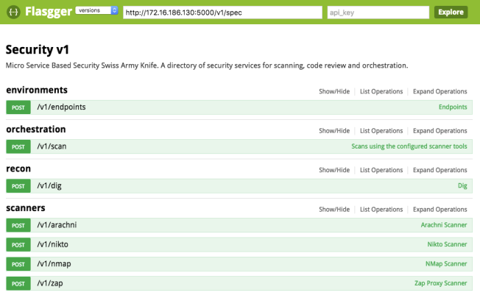
Security API

Slide 36
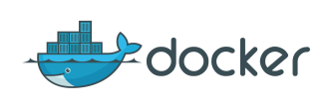
Dockerized WTE
+
OWASP WTE
Notes:
Some of the OWASP tools, dockers designed for automation not just running.

Slide 37
Weaponized Jenkins
Zero false positives
Anaphylactic shock
Health Checks vs Scanning
Run these all the time
Home of specific issue tests
Find a vuln, write a test
Cadence for longer running tests
These NEVER break the build
Every x builds or every Y days

Slide 38
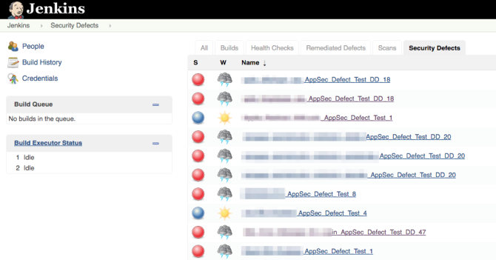
Gauntlt and Jenkins

Slide 39
Slack

Slide 40
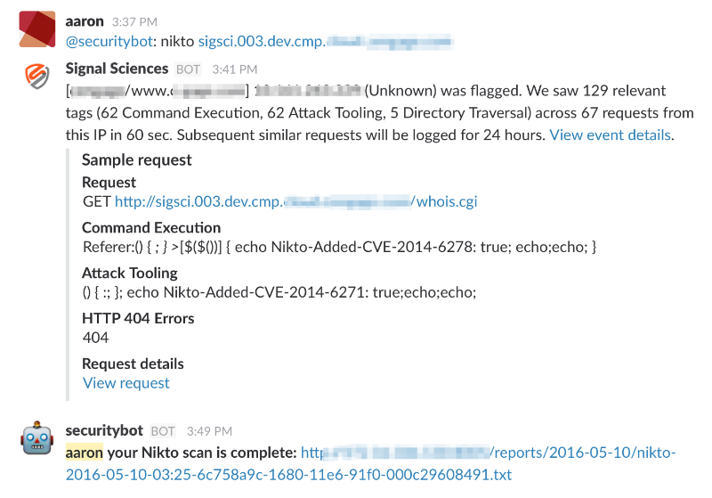
Security Bot Scanner

Slide 41
Getting Involved
Submit a Tool Review
Send us your AppSec Pipeline example
Review and contribute to the AppSec Pipeline Documentation
Contribute to supporting tools: OWASP DefectDojo, OWASP WTE Docker, Gauntlt, OWASP Pipeline
Create your own awesome tool and share

Slide 42
Future Goals
Quick Start Guide
AppSec Pipeline Cheat Sheet
More AppSec Pipeline Examples
Auto-Create Security Testing Tools (AWS/Azure)

Slide 43
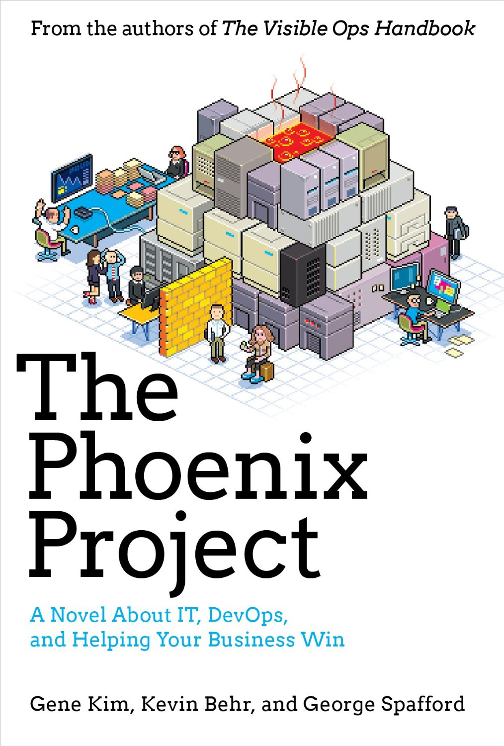
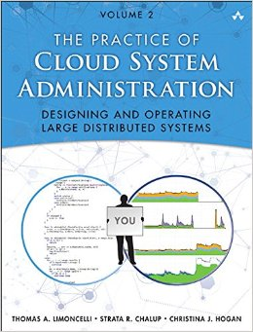
Books to Read

Slide 44
Thank You!
Keep in touch
@matt_tesauro matt.tesauro@owasp.org mtesauro@gmail.com /in/matttesauro
github.com/mtesauro
@weavera aaron.weaver@owasp.org aaron.weaver2@gmail.com /in/aweaver
github.com/aaronweaver

