Slide 1
SecDevOps: A View from the Trenches
Abhay Bhargav, CEO, we45

Slide 2
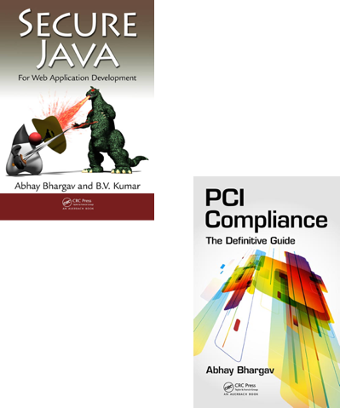
Quick Intro…
CEO of focused Application Security Company, we45
Author of two international publications
Led myriad app-pentests for clients across multiple domains
Python Junkie – with a passion for solving Security problems
Authored and ran one of the world’s first hands-on Security in DevOps Workshops
Notes:
Afternoon ladies and gentlemen, I can imagine how you’re all feeling for this session before lunch. I think the OWASP’s motto for this session was “catch em when they’re hungry”

Slide 3
Agenda
A Case for Security in DevOps (SecDevOps)
Story 1 – Confessions of a Vulnerability Scanner Junkie
Story 2 – The Anorexic Threat Model
Story 3 – Rapid Deployment == Vulnerabilities at Scale
Notes:
Towards the end of the slide – “I think there has been one line that has ruined application security for all of us. Forever.

Slide 4
Let’s test security just before we go live.
Notes:
I realized that this works, because while we claim to have embraced Agile Development and DevOps, we treat security in a very waterfall way. We cant seem to process it unless its in sequence.

Slide 5
Guiding Philosophy for me in Security
Fanatic Discipline
Empirical Creativity
Productive Paranoia

Slide 6
Guiding light in DevOps – True Productivity
Throughput -
Operating Resources
Free of Security bugs
High Quality Apps delivered
Resources consumed testing
Resources consumed fixing
Resources consumed firefighting
Increase Throughput (Deliver Apps)
Decrease Operating Expenses (Resources tied up in – testing, - bugfixes, - security failures)

Slide 7
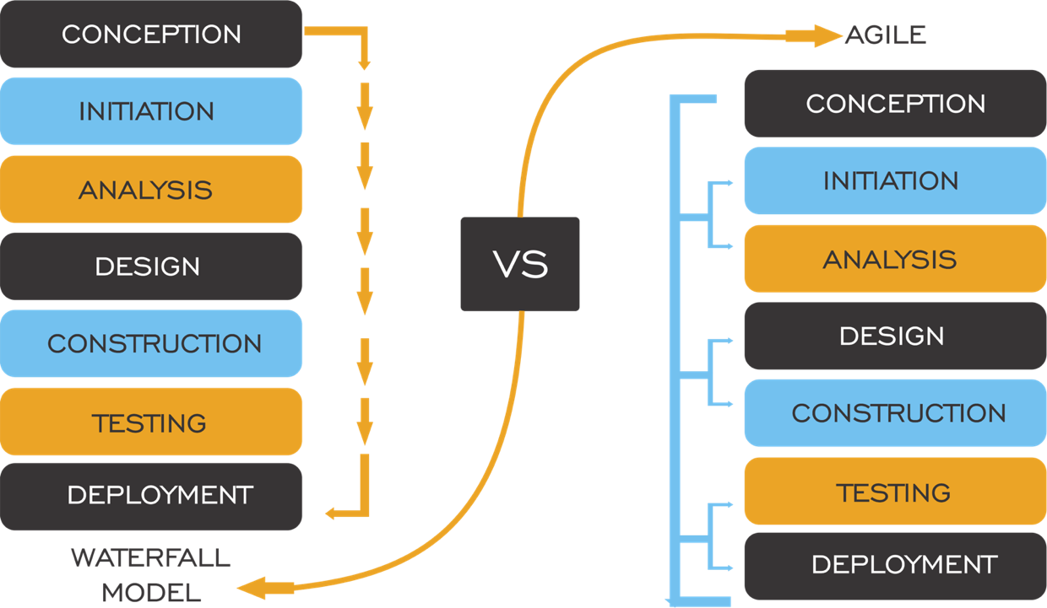
This would work when the world was like this…..

Slide 8
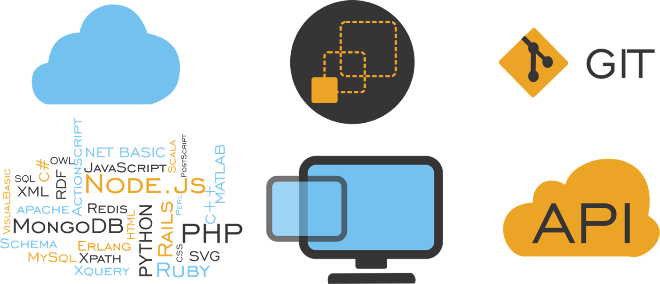
Now, The world is like this….

Slide 9
Speed and Scale
Amazon deploys every 11.6 seconds
Etsy deploys 25 times a day
Your apps are probably deployed on similar lines
Notes:
Of course, this has happened. Application Delivery just got really quick. It doesn’t matter if your Amazon or whatever, you are delivering apps this way.

Slide 10
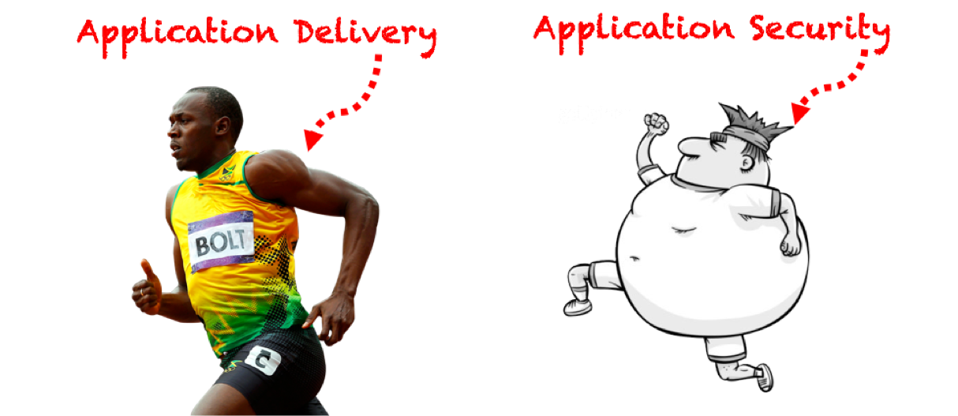
But…..
Notes:
So Application security is like this now….

Slide 11
Application Security Bottleneck
Releases are blocked until security vulnerabilities are fixed,
resulting in:
Higher Operational Resources to fix Security Bugs
Slower Release Cycles
Slower Throughput
Breakdown of Agile and DevOps
Customers going ☹

Slide 12
Story 1 – The Application Vulnerability Scanner Junkie
Working with a Fintech Client
5 deploys a day
Mature DevOps Processes
Working with SAST and DAST in DevOps
Seems Perfect, Right?

Slide 13
Problem Statement
Their Customer Pentests constantly came up with Critical and High Severity Issues
They seemed to be missing several vulnerabilities – every release
No unified perspective on Vulnerabilities
No validation on False positives

Slide 14
Our Diagnosis
ZAP with Jenkins was giving them minimal coverage
Authentication – AJAX Driven was hard to automate with standard headless ZAP
Web Services Test Quality– very poor
No “Second Opinion”
All possibly leading to one conclusion……

Slide 16
Green – Identified with Automated Vulnerability Scanning
Yellow – Partially Identified with Automated Vulnerability Scanning
Grey – Identified only with manual security testing

Slide 17
Our Solution - Coverage
L1 Coverage:
Leverage ZAP API – Test better with Authentication + Multi-Browser Headless
Second Opinion with the w3af REST API
Integrate Nessus and Nikto for Low-Level Findings
L2 Coverage:
Customized Selenium Scripts for specific threat models
PyRESTTest Test Scripts for specific Web-Services driven Threat Models

Slide 18
OWASP ZAP + Custom Authentication

Slide 19
Useful API Calls – OWASP ZAP API
zap.spider.scan()
Zap Spider + Authentication
zap.pscan.scan()
Passive Scan
zap.ascan.scan()
ZAP Active Scan
zap.params.params()
Enumerate all Parameters
zap.core.alerts()
All alerts generated by the scan

Slide 20
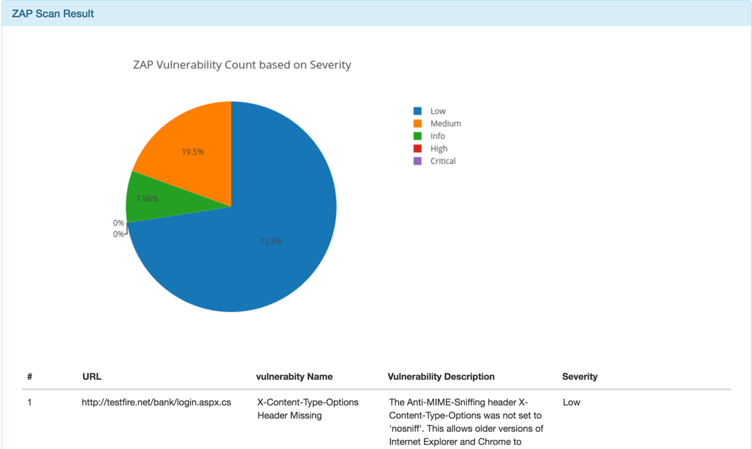
ZAP API - Artefacts

Slide 21
w3af API
w3af’s API is very detailed and easy to use
HTTP REST API – Detailed views and datasets
Configurable Scan Profiles

Slide 22
How we used w3af’s API
QA - Runs functional tests with all params
Capture QA Tests with mitmproxy and base64 requests
Run w3af with API
Pull results + report

Slide 23
Quick Primer – w3af REST API
/scans/ resource to launch scans
/scan/<id>/status to get the scan status
/scan/<id>/kb – details of the vulnerabilities identified
/scan/<id>/kb/<vul-id> detailed info about the vulnerability
/scan/<id>/traffic = details of traffic

Slide 24
W3af API DEMO

Slide 25
Custom Application Security Testing
Selenium + Python/Java - Custom Web Application Security Scripts
Scaled Multi-Browser Security Testing
webdriver.Ie()
webdriver.Firefox()
webdriver.Chrome()
webdriver.PhantomJS()
Run as Unit Tests/Standalone Tests for the application
pyresttest or requests for REST based API testing
YAML based payloads
Asserts and comparisons can be easily benchmarked

Slide 26
Integration with CI/CD Pipeline
Run multiple scanning tools/engines with Jenkins/other CI tools
Run as tasks within Jenkins
Run Reports within/outside Jenkins
Forward Integration
Bug Tracker Databases – JIRA, etc.

Slide 27
Custom Application Security Testing Scripts + Jenkins
Vulnerabilities:
Insecure Direct Object Reference over AJAX
Insecure Cryptographic Storage
Session Fixation

Slide 28
Story 2 – The Anorexic Threat Model
Threat Modeling is dead, Long live the Threat Model!
Problems of Threat Modeling in a DevOps World
Practical Approaches to Threat Modeling with Agile and DevOps

Slide 30
Everything wrong with Threat Models Today
Assumption of frozen requirements – Very Waterfall!
Threat Models are not dynamic enough – Out of date with application delivery
Current Threat Modeling is not collaborative – Bunch of Security folks at the beginning of a project

Slide 31
Requirements – Threat Modeling in a DevOps World
Just like deployment – Threat Models must be broken down into smaller and more regular chunks
Think of a SCRUM user story and integrate it into the sprint as an “Abuser Story”
Engage collaboratively with Agile Team-members

Slide 32
Abuser Stores – Threat Models
Benefits - Iterative Threat Modeling
Security Test Cases
Prioritzation of Bugfixes
Creating Security pipelines

Slide 33
Agile Threat Modeling Example

Slide 34
Story 3 – Rapid Deployments == Vulnerabilities at Scale
Docker, Infrastructure as Code is great, but…..
Security Failures in IaC
Practical Steps:
Security Testing IaC Deployments
Other practices

Slide 35
Docker is great, but…..
Shellshock?
Heartbleed?
Ouch!

Slide 36
They are trying hard, but….

Slide 37
IaC Scripts are great, but….
NoSQL/KV DB Products are hard to secure:
MongoDB
Elasticsearch
Redis
Message Queue and Cache Products are worse:
RabbitMQ
Memcached

Slide 38
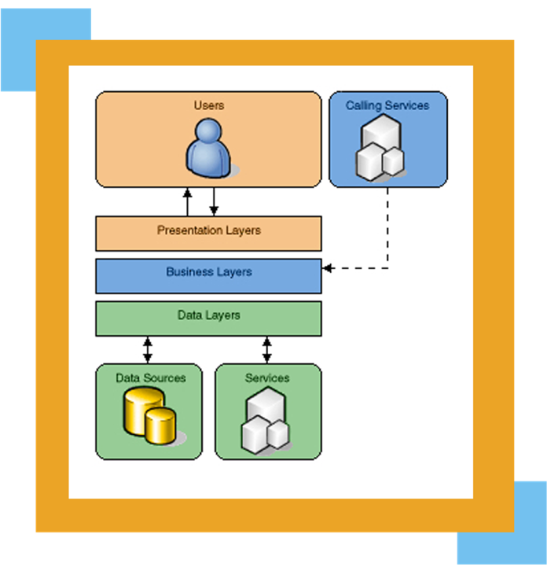
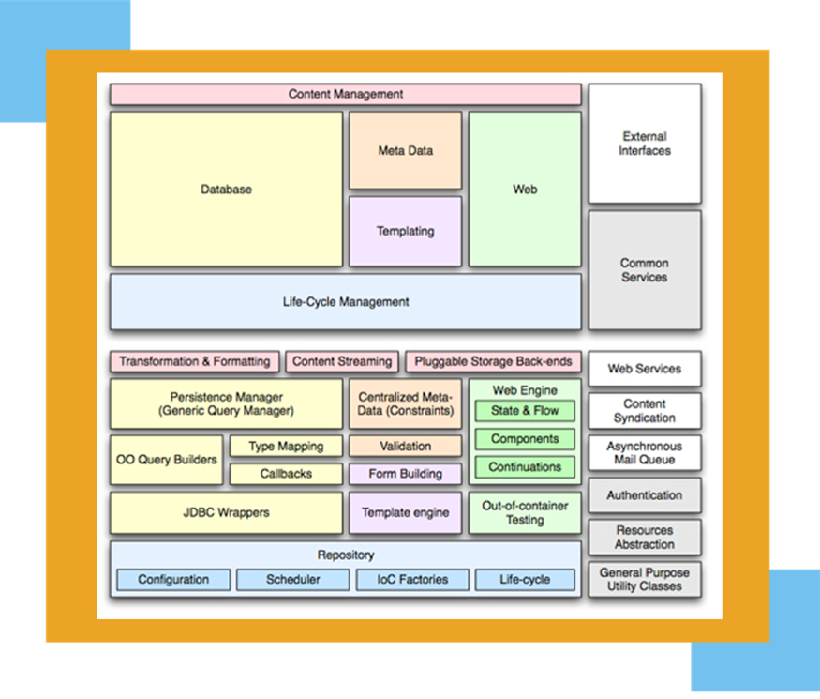
The Stack has gotten pretty complex
Before
After

Slide 39
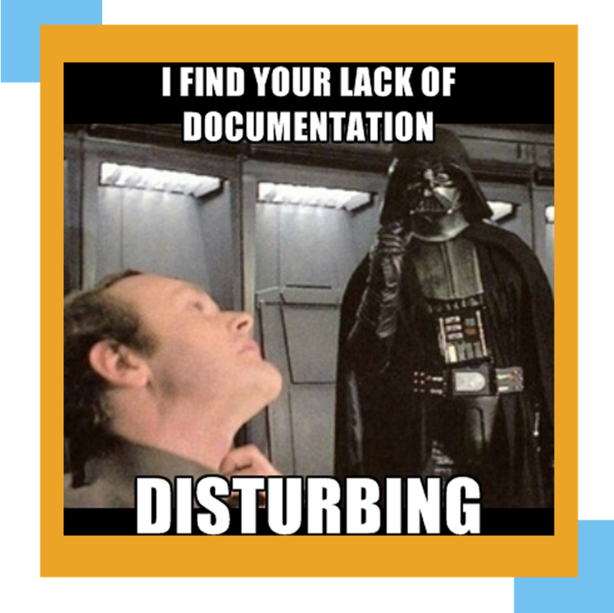
Lack of Documentation
Security in Configs are hard to locate
In-house Security documentation - nearly non-existent
“Security Hardening Documents” - mostly for Audit purposes

Slide 40
How do we solve this?
Higher awareness:
Hardening Framework for IaC => https://github.com/dev-sec
Validation
Integrating Security Scanners with IaC Deployments + Specialized Scripts
Nmap + NSE Scripts for Specific deployments
Lynis
Integration with Vulnerability Feeds
Code Review?

Slide 41
Demo – Fabric IaC + Mongo and Nginx Hardening

Slide 42
Conclusion
DevOps and Security can play well together
We just need to fit the pieces
And keep it fitted as continuously as possible

Slide 43
Thank You!
Email: abhay@we45.com
Twitter: @abhaybhargav
LinkedIn: www.linkedin.com/in/abhaybhargav

