Slide 1
Play, Hack and Track
Amit Ashbel
Cyber Security Evangelist

Slide 2
How I am about to spend your time?
What is GoH?
What's behind it?
Not so wet T-Shirt contest
Node.js potential risks
Takeaways

Slide 3
When was OWASP Top 10 published for the first time?
Notes:
First OWASP top 10 List was published in 2003

Slide 4
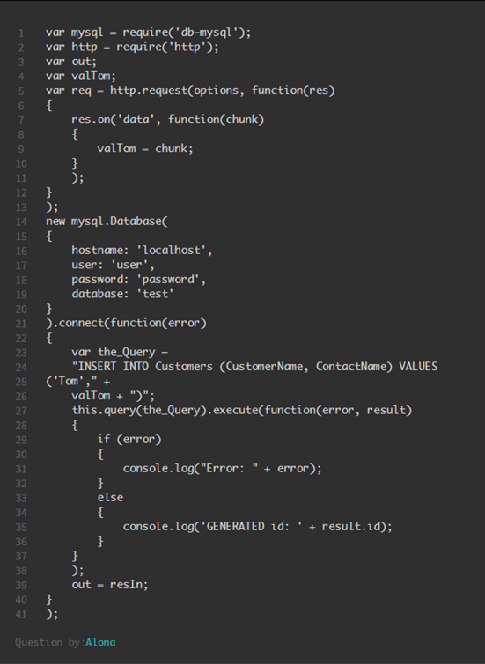
Still making the same mistakes!
Instagram –
A2-Broken Authentication and Session Management
A5-Security Misconfiguration
LinkeIn, tumblr, Instagram and others
A6-Sensitive data exposure
Notes:
Just in the past few months there have been so many large breaches reported where data was stolen…..While there is not much info about how the data was retrieved, its clear that in some cases the data was not encrypted properly.

Slide 5
Why?

Slide 6
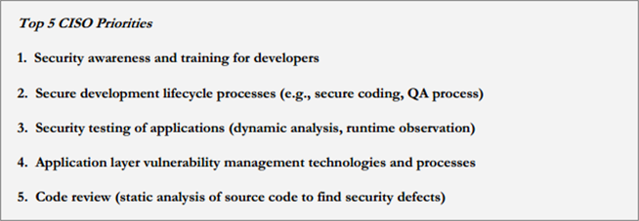
CISO Concerns – Education & Awareness

Slide 7
What Are Your Top Challenges In Implementing Application Security.
Lack of application security skills, tools and methods
37.8%
Lack of funding or management buy­-in
36.8%
Silos between security, development and business units
32.9%
Identifying all applications in the portfolio
32.2%
Fear of modifying production code (might “break the app”)
27.6%
Shortage of technical resources to maintain security in production applications
21.7%
Lack of integrated security and remediation life cycle workflow
20.7%
Waiting for service releases to fix problems
14.1%
SANS AppSec Survey 2016
Notes:
400 security managers answered The SANS Application Security Survey and results clearly show that Skill shortage is way up there.
We cant do much about budgets but we definitely believe that education and skill development is a challenge organizations can easily tackle and here is proof!

Slide 8
Game of Hacks – An idea is born
using System;
using System.Security.Cryptography;
class Program
{
static void Main()
{
using (RNGCryptoServiceProvider rng = new RNGCryptoServiceProvider())
{
// Buffer storage.
byte[] data = new byte[4];
// Ten iterations.
for (int i = 0; i < 10; i++)
{
// Fill buffer.
rng.GetBytes(data);
Spot The
Vulnerability

Slide 9
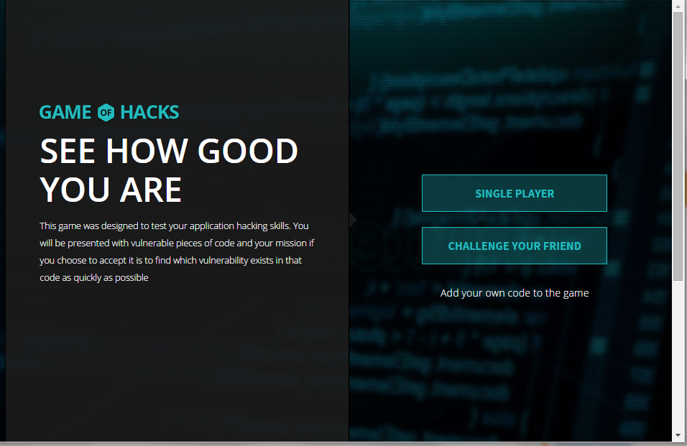
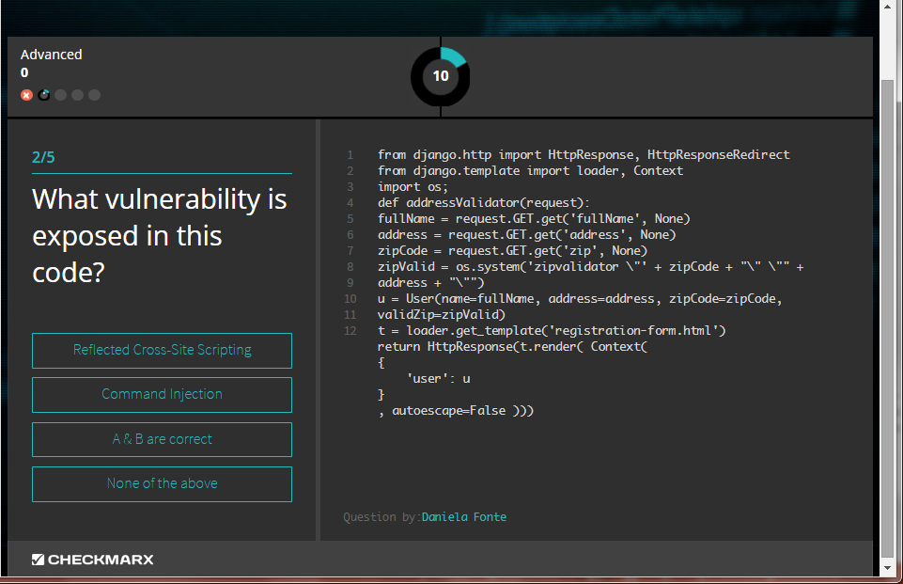
1+1=?
Launched 2015
More than 200,000 games were played since

Slide 10
Let’s take a look at the game

Slide 11
What was behind GoH?

Slide 12
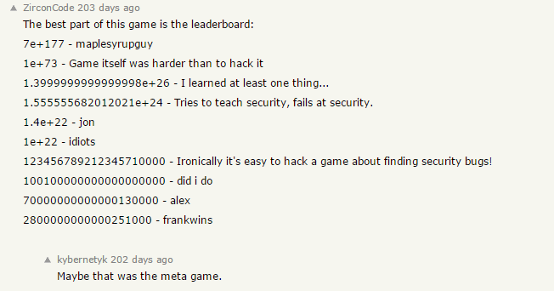
Honeypot
We assumed the game would be attacked
We might as well learn from it
Vulnerabilities were left exposed and patched along the way

Slide 13
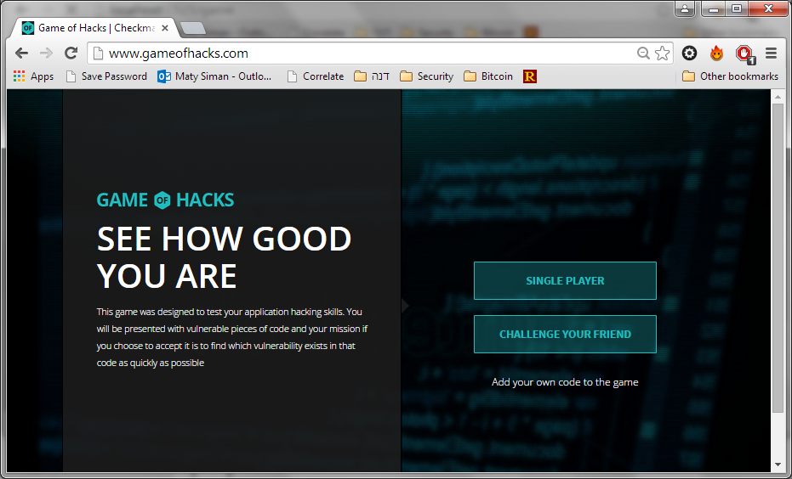
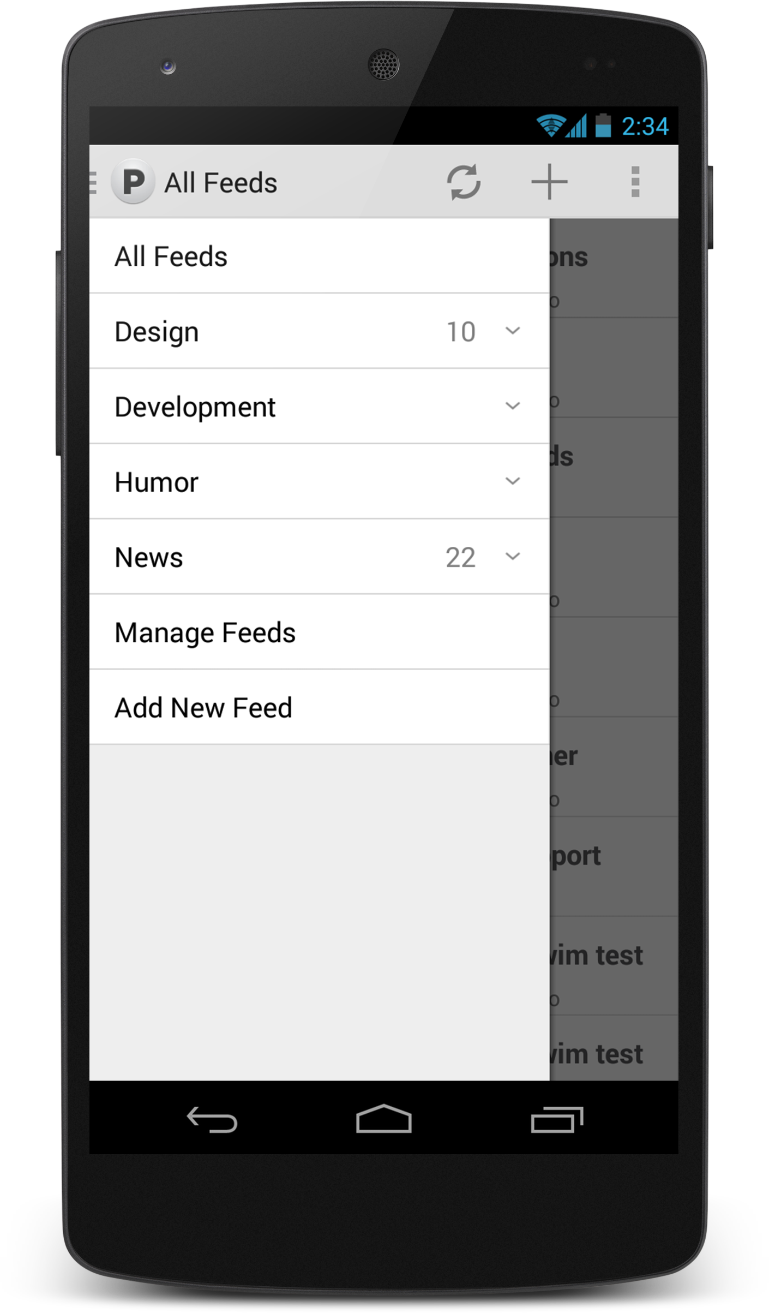
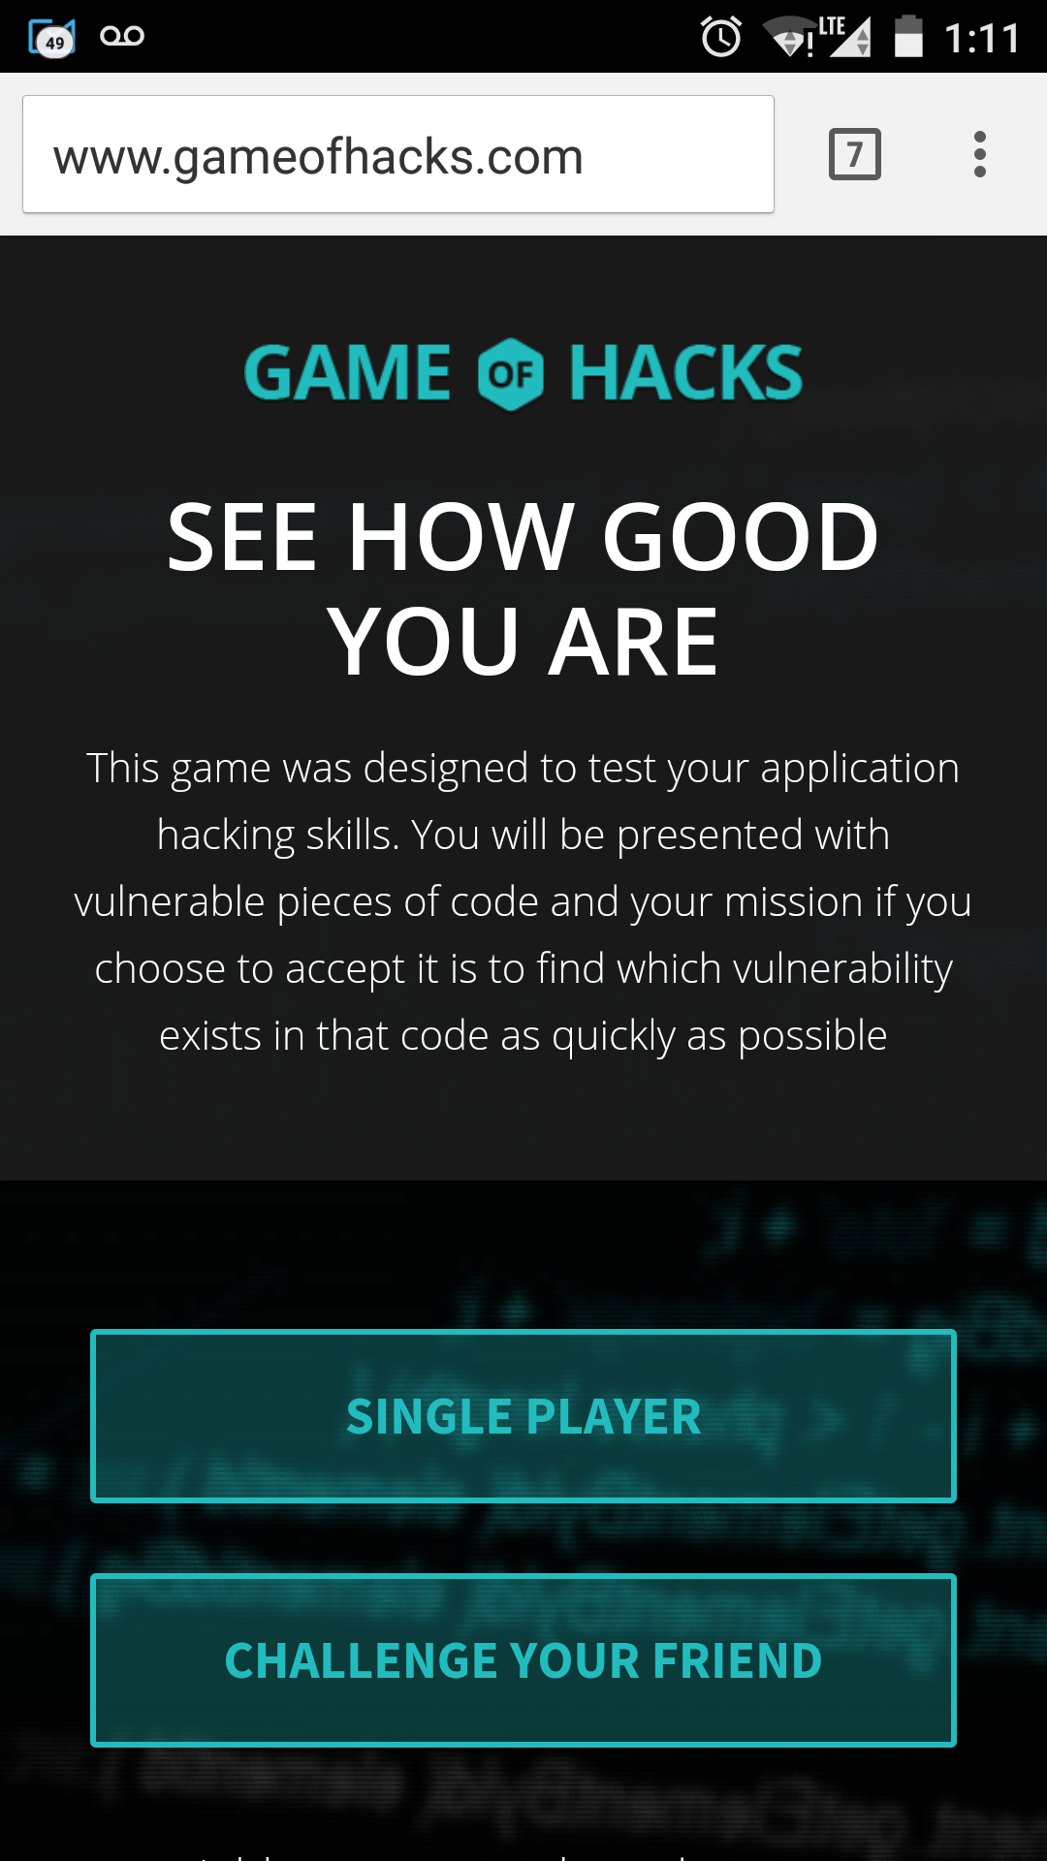
GoH Architecture
Server
Client

Slide 14
Node.js architecture
Single Thread Architecture - Event Loop
Register Callback
File System
Event Queue
Event Loop
Single Thread
Database
Network
Operation Complete Trigger Callback

Slide 15
Event Driven
Single Thread
Events handler

Slide 16
Game Entities
Question #
60-Second Timer
Code Snippet
Difficulty Level
Score
Question
Answers
16

Slide 17
Vuln. #1 Answered Question
Initially users initiated app.sendAnswers multiple times, until they got “Correct answer” response.
This allowed malicious users to systematically locate the correct answer and to gain points over and over for the same question.
Solutions
“Question Already Answered” flag added

Slide 18
Timer
GoH Version 1
Timer handled by client
User forced to go to next question when time ends
Client sends to server Answer + Time spent
GoH Version 2
Time is now computed at the server with minor traffic influence

Slide 19
Timer
What Else?

Slide 20
Turn your mobile devices ON!
Go to: www.kahoot.it

Slide 21
More Node.js points to remember

Slide 22
Event Driven - remember?
Single Thread
Events handler

Slide 23
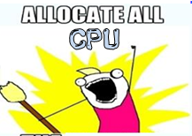
Demo
http://localhost:49090/sum?p=5
http://localhost:49090/sum?p=100000000
http://localhost:49090/sum?p=5

Slide 24
Denial of Service
Function sum (p)
for (i=1;i<=p;++i)
{
f=f+i;
}

Slide 25
Node.js DoS

Slide 26
JSON-based SQL Injection
Node.JS, being a JSON based language, can accept JSON values for the .find method:
A user can bypass it by sending
http:///server/page?user[$gt]=a&pass[$gt]=a
http://blog.websecurify.com/2014/08/hacking-nodejs-and-mongodb.html
26

Slide 28
ReDoS
db.users.find({username: username});
bcrypt.compare(candidatePassword, password, cb);
This can lead to Regular Expression Denial of Service through the {“username”: {“$regex”: “……..}}
So always validate the input length, structure and permitted characters
Remembering that Node.js is highly sensitive to CPU-intensive tasks, and there’s a single thread for user-code – ReDoS is really bad
JSON-base SQL Injection

Slide 29
Re-Dos Demo
http://localhost:49090/?user=admin&pass[$regex]=^(a|a|a|a|a|a|a|a|a|a|a|a|a|a|a|a|a|a|a|a|a|a|a|a|a|a|a|a|a|a|a|a|a|a|a|a|a|a|a|a|a|a|a|a|a|a|a|a|a|a|a|a|a|a|a|a|a|a|a|a|a|a|a|a|a|a|a|a|a|a|a|a|a|a|a|a|a|a|a|a|a|a|a|a|a|a|a|a|a|a|a|a|a|a|a|a|a|a|a|a|a|a|a|a|a|a|a|a|a|a|a|a|a|a|a|a|a|a|a|a|a|a|a|a|a|a|a|a|a|a|a|a|a|a|a|a|a|a|a|a|a|a|a|a|a|a|a|a|a|a|a|a|a|a|a|a|a|a|a|a|a|a|a|a|a|a|a|a|a|a|a|a|a|a|a|a|a|a|a|a|a|a|a|a|a|a|a|a|a|a|a|a|a|a|a|a|a|a|a|a|a|a|a|a|a|a|a|a|a|a|a|a|a|a|a|a|a|a|a|a|a|a|a|a|a|a|a|a|a|a|a|a|a|a|a|a|a|a|a|a|a|a|a|a|a|a|a|a|a|a|a|a|a|a|a|a|a|a|a|a|a|a|a|a|a|a|a|a|a|a|a|a|a|a|a|a|a|a|a|a|a|a|a|a|a|a|a|a|a|a|a|a|a|a|a|a|a|a|a|a|a|a|a|a|a|a|a|a|a|a|a|a|a|a|a|a|a|a|a|a|a|a|a|a|a|a|a|a|a|a|a|a|a|a|a|a|a|a|a|a|a|a|a|a|a|a|a|a|a|a|a|a|a|a|a|a|a|a|a|a|a|a|a|a|a|a|a|a|a|a|a|a|a|a|a|a|a|a|a|a|a|a|a|a|a|a|a|a|a|a|a|a|a|a|a|a|a|a|a|a|a|a|a|a|a|a|a|a|a|a|a|a|a|a|a|a|a|a|a|a|a|a|a|a|a|a|a|a|a|a|a|a|a|a|a|a|a|a|a|a|a|a|a|a|a|a|a|a|a|a|a|a|a|a|a|a|a|a|a|a|a|a|a|a|a|a|a|a|a|a|a|a|a|a|a|a|a|a|a|a|a|a|a|a|a|a|a|a|a|a|a|a|a|a|a|a|a|a|a|a|a|a|a|a|a|a|a|a|a|a|a)(d|d|d|d|d|d|d|d|d|d|d|d|d|d|d|d|d|d|d|d|d|d|d|d|d|d|d|d|d|d|d|d|d|d|d|d|d|d|d|d|d|d|d|d|d|d|d|d|d|d|d|d|d|d|d|d|d|d|d|d|d|d|d|d|d|d|d|d|d|d|d|d|d|d|d|d|d|d|d|d|d|d|d|d|d|d|d|d|d|d|d|d|d|d|d|d|d|d|d|d|d|d|d|d|d|d|d|d|d|d|d|d|d|d|d|d|d|d|d|d|d|d|d|d|d|d|d|d|d|d|d|d|d|d|d|d|d|d|d|d|d|d|d|d|d|d|d|d|d|d|d|d|d|d|d|d|d|d|d|d|d|d|d|d|d|d|d|d|d|d|d|d|d|d|d|d|d|d|d|d|d|d|d|d|d|d|d|d|d|d|d|d|d|d|d|d|d|d|d|d|d|d|d|d|d|d|d|d|d|d|d|d|d|d|d|d|d|d|d|d|d|d|d|d|d|d|d|d|d|d|d|d|d|d|d|d|d|d|d|d|d|d|d|d|d|d|d|d|d|d|d|d|d|d|d|d|d|d|d|d|d|d|d|d|d|d|d|d|d|d|d|d|d|d|d|d|d|d|d|d|d|d|d|d|d|d|d|d|d|d|d|d|d|d|d|d|d|d|d|d|d|d|d|d|d|d|d|d|d|d|d|d|d|d|d|d|d|d|d|d|d|d|d|d|d|d|d|d|d|d|d|d|d|d|d|d|d|d|d|d|d|d|d|d|d|d|d|d|d|d|d|d|d|d|d|d|d|d|d|d|d|d|d|d|d|d|d|d|d|d|d|d|d|d|d|d|d|d|d|d|d|d|d|d|d|d|d|d|d|d|d|d|d|d|d|d|d|d|d|d|d|d|d|d|d|d|d|d|d|d|d|d|d|d|d|d|d|d|d|d|d|d|d|d|d|d|d|d|d|d|d|d|d|d|d|d|d|d|d|d|d|d|d|d|d|d|d|d|d|d|d|d|d|d|d|d|d|d|d|d|d|d|d|d|d|d|d|d|d|d|d|d|d|d|d|d|d|d|d|d|d|d|d|d|d|d|d|d|d|d|d|d|d|d|d|d|d|d|d|d|d|d|d|d|d|d|d|d|d|d|d|d|d|d|d|d|d|d|d|d|d|d|d|d|d|d|d|d|d|d|d|d|d|d|d|d|d|d|d|d|d|d|d|d|d|d|d|d|d|d|d|d|d|d|d|d|d|d|d|d|d|d|d|d|d|d|d|d|d|d|d|d|d|d|d|d|d|d|d|d|d|d|d|d|d|d|d|d|d|d|d|d|d|d|d|d|d|d|d|d|d|d|d|d|d|d|d|d|d|d|d|d|d|d|d|d|d|d|d|d|d|d|d|d|d|d|d|d|d|d|d|d|d|d|d|d|d|d|d|d|d|d|d|d|d|d|d|d|d|d|d|d|d|d|d|d|d|d|d|d|d|d|d|d|d|d|d|d|d|d|d|d|d|d|d|d|d|d|d|d|d|d|d|d|d|d|d|d|d|d|d|d|d|d|d|d|d|d|d|d|d|d|d|d|d|d|d|d|d|d|d|d|d|d|d|d|d|d|d|d|d|d|d|d|d|d|d|d|d|d|d|d|d|d|d|d|d|d|d|d|d|d|d|d|d|d|d|d|d|d|d|d|d|d|d|d|d|d|d|d|d|d|d|d|d|d|d|d|d|d|d|d|d|d|d|d)$

Slide 30
Some Key Takeaways
Gamification of education
Knowledge is key to deliver secure code
Students (of all ages) absorb and retain information better
Anytime you have a chance to make learning a fun experience you should do it
Using code
Always validate the input length, structure and permitted characters
Each coding language has its own pitfalls
Research and learn a language before you use it publicly.
Remember - Node.js is highly sensitive to CPU-intensive tasks

Slide 31
Thank You!
Questions?
amit.ashbel@checkmarx.com
Amit Ashbel
@aashbel

