Slide 1
Idiot proof is not enough, make it villain proof!
Liesbeth Kempen

Slide 2
Who am I?
liesbeth.kempen@fox-it.com

Slide 3
Who are you?

Slide 4
Contents
Starting with my True Story
More Tales from the Trenches
How to make it villain proof!
How to convince management

Slide 5
Code first, security later
A True Story…

Slide 6
Contents
Starting with my True Story
More Tales from the Trenches
How to make it villain proof!
How to convince management

Slide 7
Tales from the audit team
Only issues from reports are fixed
Or not really!

Slide 8
Tales from the audit team
Using templates works
Add-ons are buggier then ever!

Slide 9
Contents
Starting with my True Story
More tales from the trenches
How to make it villain proof!
How to convince management

Slide 10
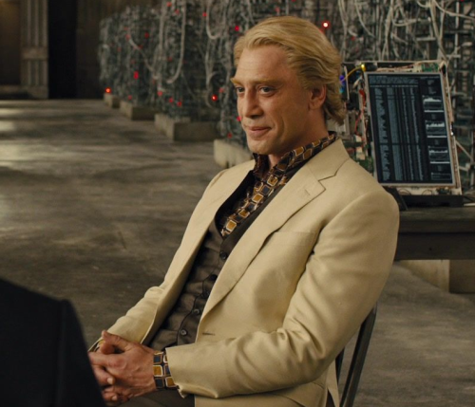
Think like a villain!
Awareness training

Slide 11
Keep calm and use the standards
Notes:
Security architecture review, security code review outside of team

Slide 12
Keep calm and use the standards
Think about your process
And start with the easy changes

Slide 13
A backup plan
Vulnerability scanning
Network monitoring
Endpoint protection

Slide 14
Contents
Start with my true story
More tales from the trenches
How to make it villain proof!
How to convince management

Slide 15
Stats & examples

Slide 16
Stats & examples

Slide 18
Security is not a technical problem
Organizational changes
Feeling responsible together
(good) external reports can help

Slide 19
Security must be a choice
Crown Jewels
Reputation
Accept the security breach, or clean a litter box.
Take your pick.

Slide 20
?

Slide 21
Thank you!
liesbeth.kempen@fox-it.com

